Slide 1

Artificial
Neural Network

Slide 2
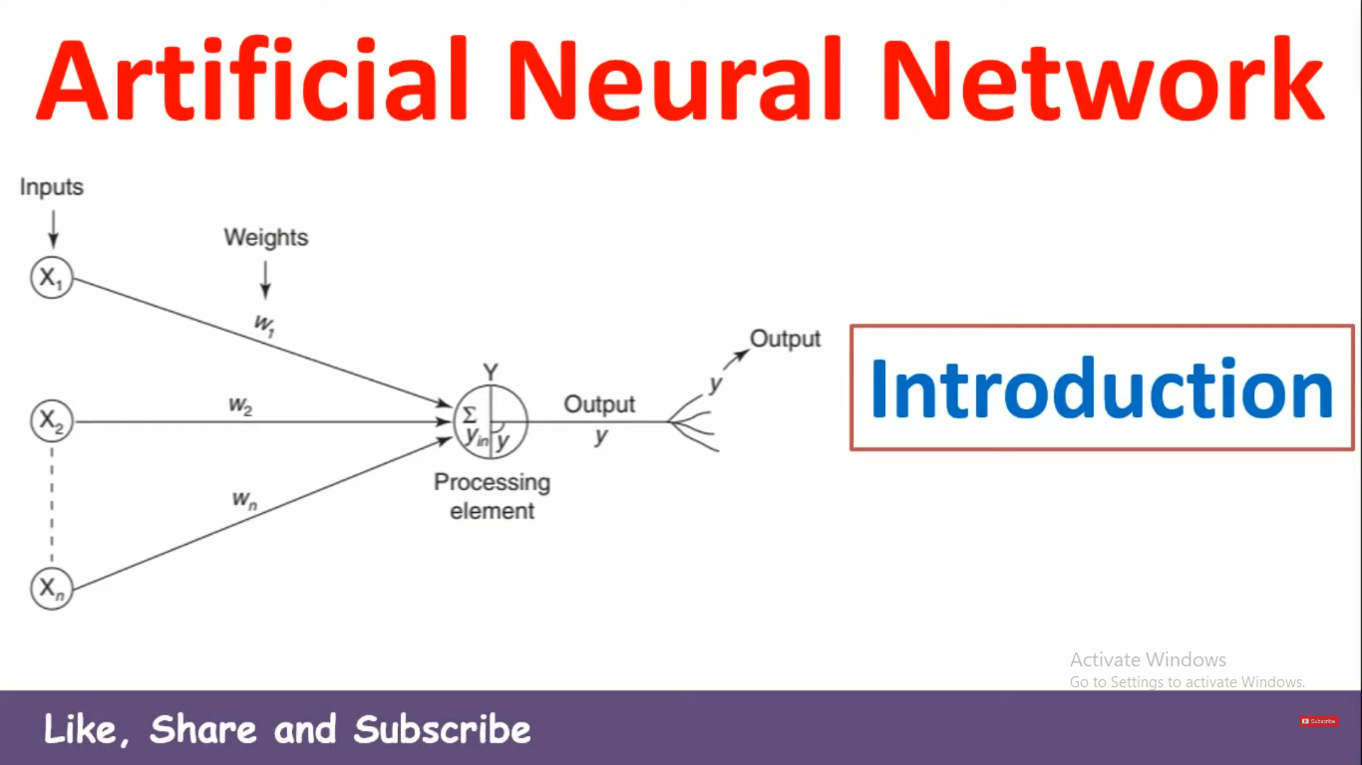

Slide 3
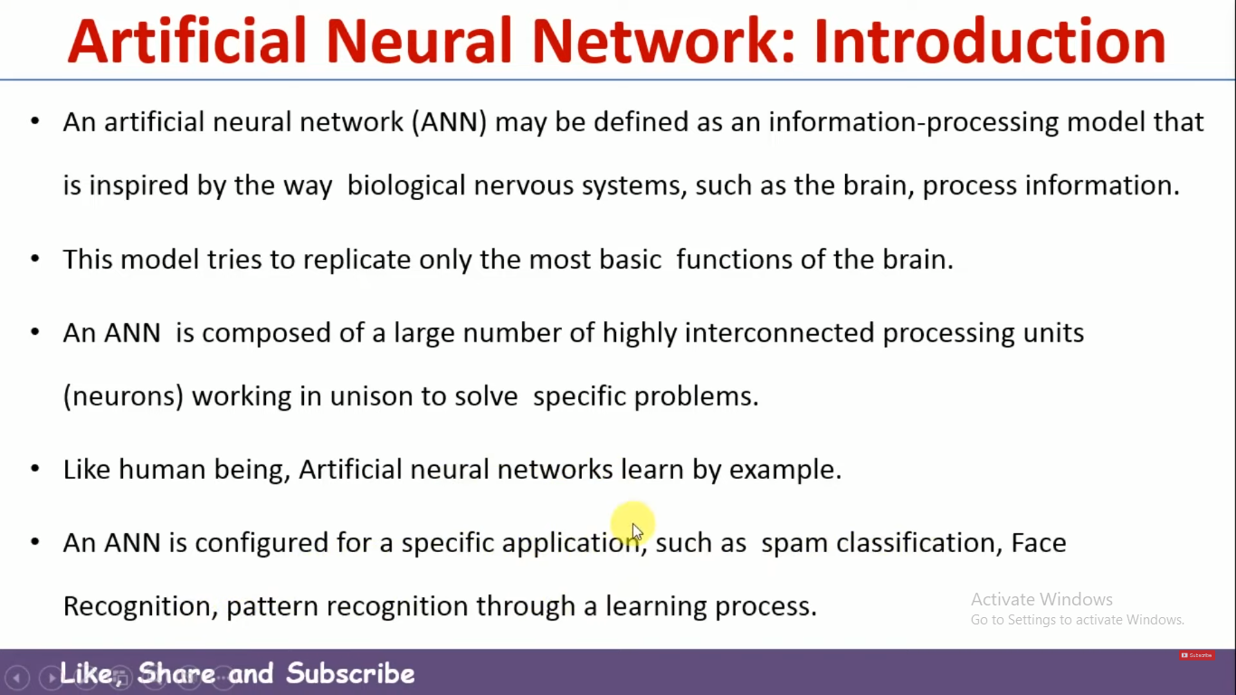

Slide 4
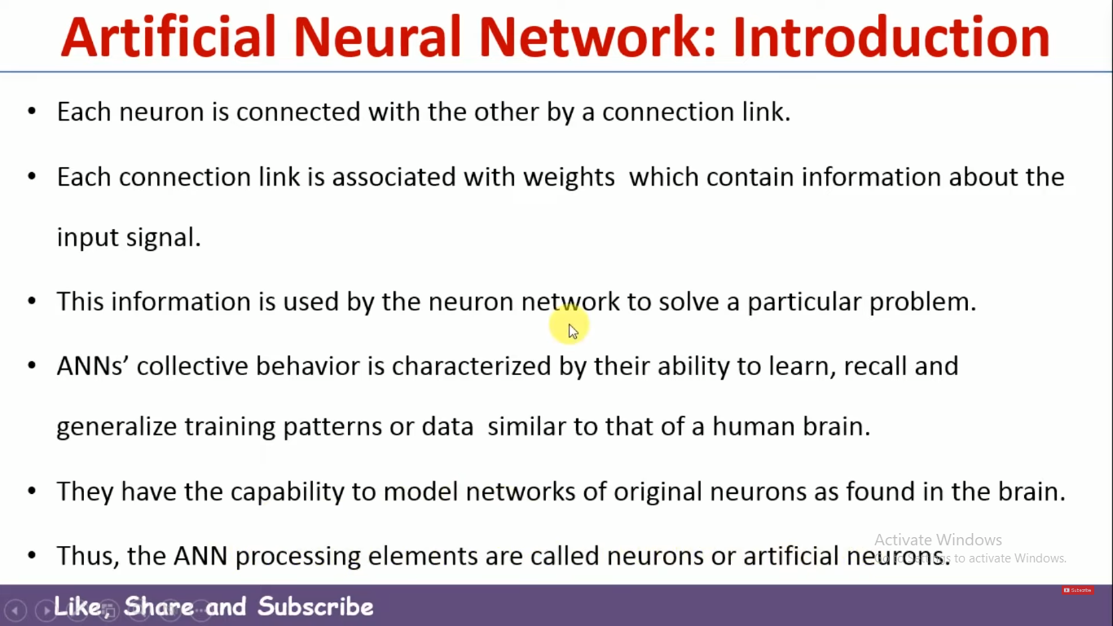

Slide 5
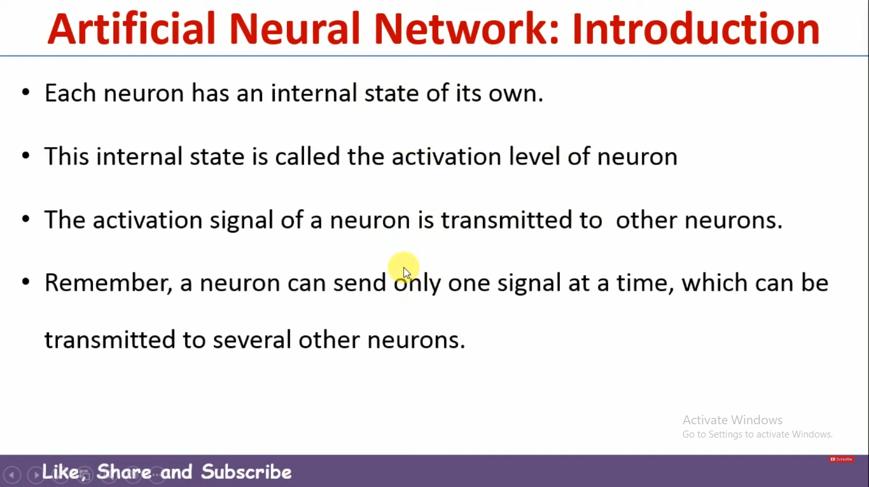

Slide 6
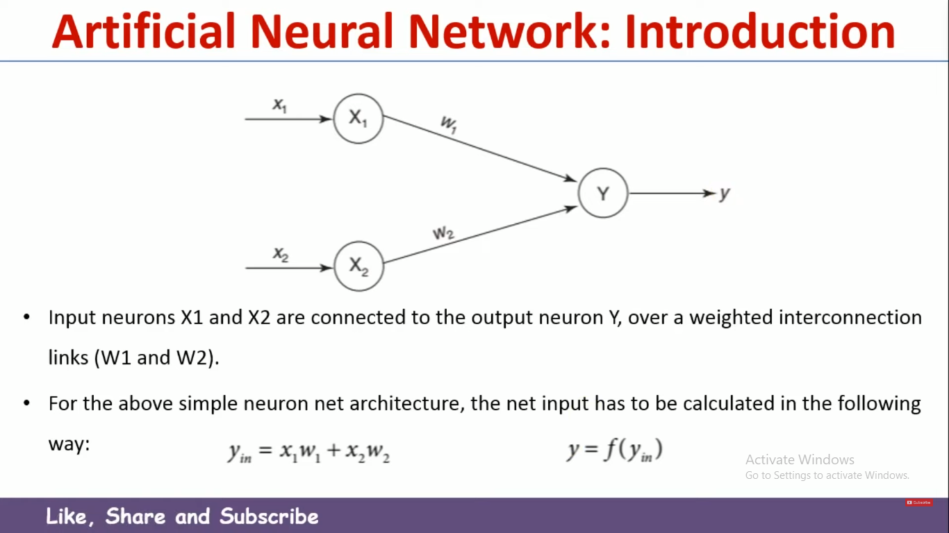

Slide 7
WEIGHT
Weights are numerical values associated with the connections between neurons. They determine the strength of these connections and, in turn, the influence that one neuron’s output has on another neuron’s input. Think of weights as the coefficients that adjust the impact of incoming data. They can increase or decrease the importance of specific information.
During the training phase of a neural network, these weights are adjusted iteratively to minimize the difference between the network’s predictions and the actual outcomes. This process is akin to fine-tuning the network’s ability to make accurate predictions.
Let’s consider a practical example to illustrate the role of weights. Suppose you’re building a neural network to recognize handwritten digits. Each pixel in an image of a digit can be considered an input to the network. The weights associated with each pixel determine how much importance the network places on that pixel when making a decision about which digit is represented in the image.
As the network learns from a dataset of labeled digits, it adjusts these weights to give more significance to pixels that are highly correlated with the correct digit and less significance to pixels that are less relevant. Over time, the network learns to recognize patterns in the data and make accurate predictions.

Slide 8
Biases: Introducing Flexibility and Adaptability
While weights determine the strength of connections between neurons, biases provide a critical additional layer of flexibility to neural networks. Biases are essentially constants associated with each neuron. Unlike weights, biases are not connected to specific inputs but are added to the neuron’s output.
Biases serve as a form of offset or threshold, allowing neurons to activate even when the weighted sum of their inputs is not sufficient on its own. They introduce a level of adaptability that ensures the network can learn and make predictions effectively.
To understand the role of biases, consider a simple example. Imagine a neuron that processes the brightness of an image pixel. Without a bias, this neuron might only activate when the pixel’s brightness is exactly at a certain threshold. However, by introducing a bias, you allow the neuron to activate even when the brightness is slightly below or above the threshold.
This flexibility is crucial because real-world data is rarely perfectly aligned with specific thresholds. Biases enable neurons to activate in response to various input conditions, making neural networks more robust and capable of handling complex patterns.
During training, biases are also adjusted to optimize the network’s performance. They can be thought of as fine-tuning parameters that help the network fit the data better.

Slide 9
What is the role of the bias in neural networks?
Answer: Bias in neural networks adjusts the intercept of the decision boundary, aiding in fitting the data more accurately.

Slide 10
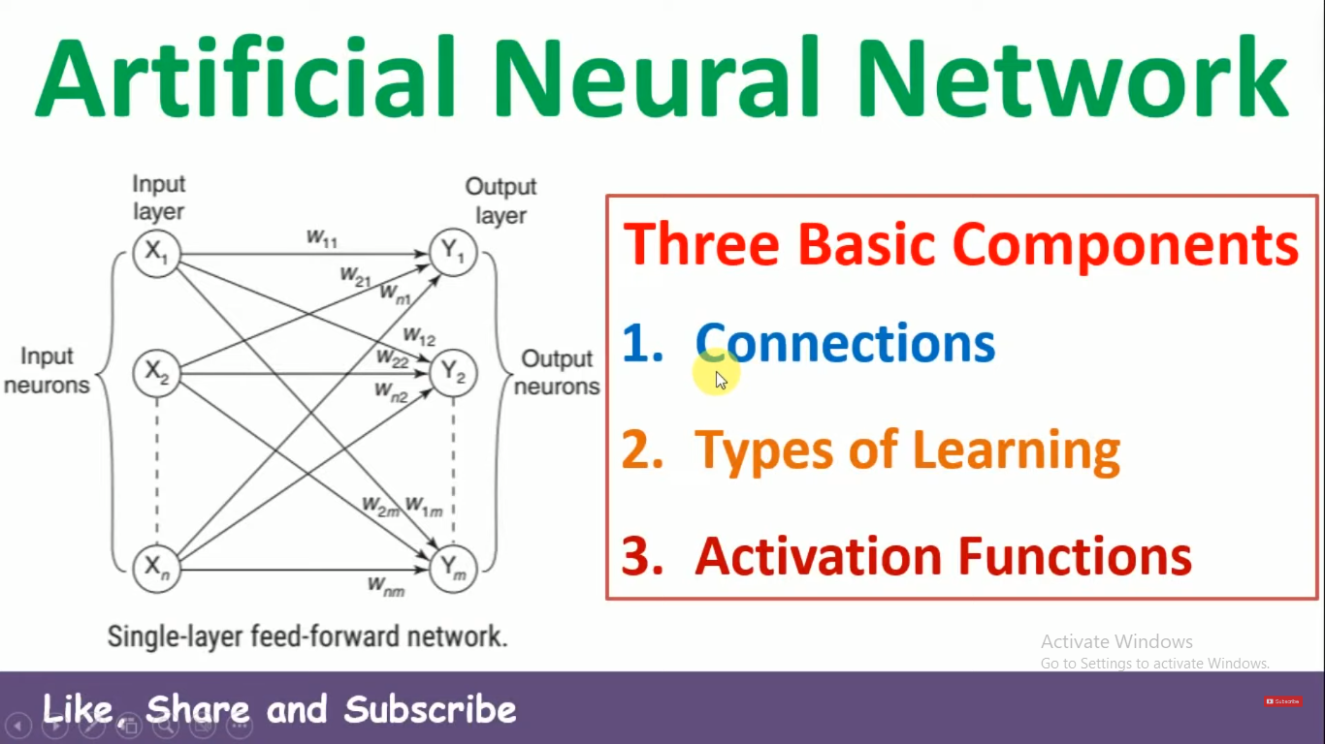

Slide 11


Slide 12


Slide 13
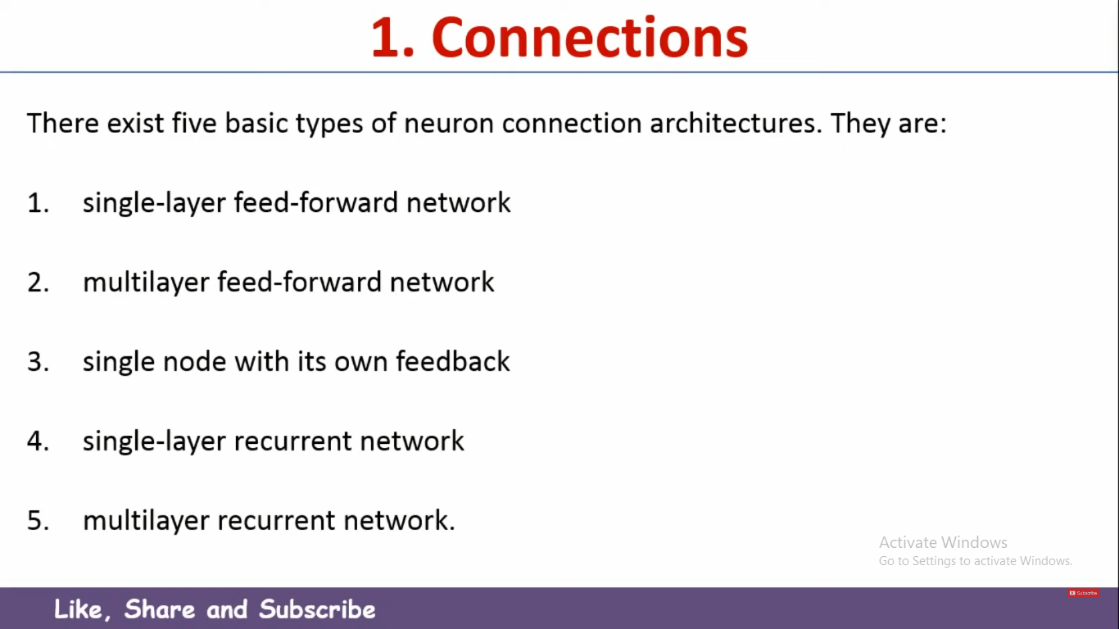

Slide 14
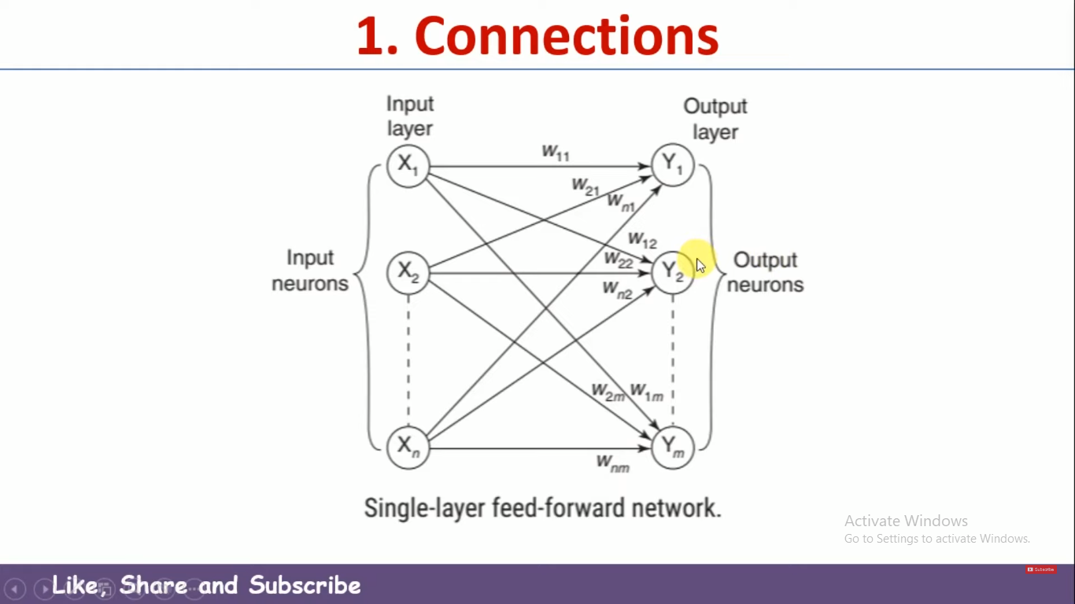

Slide 15
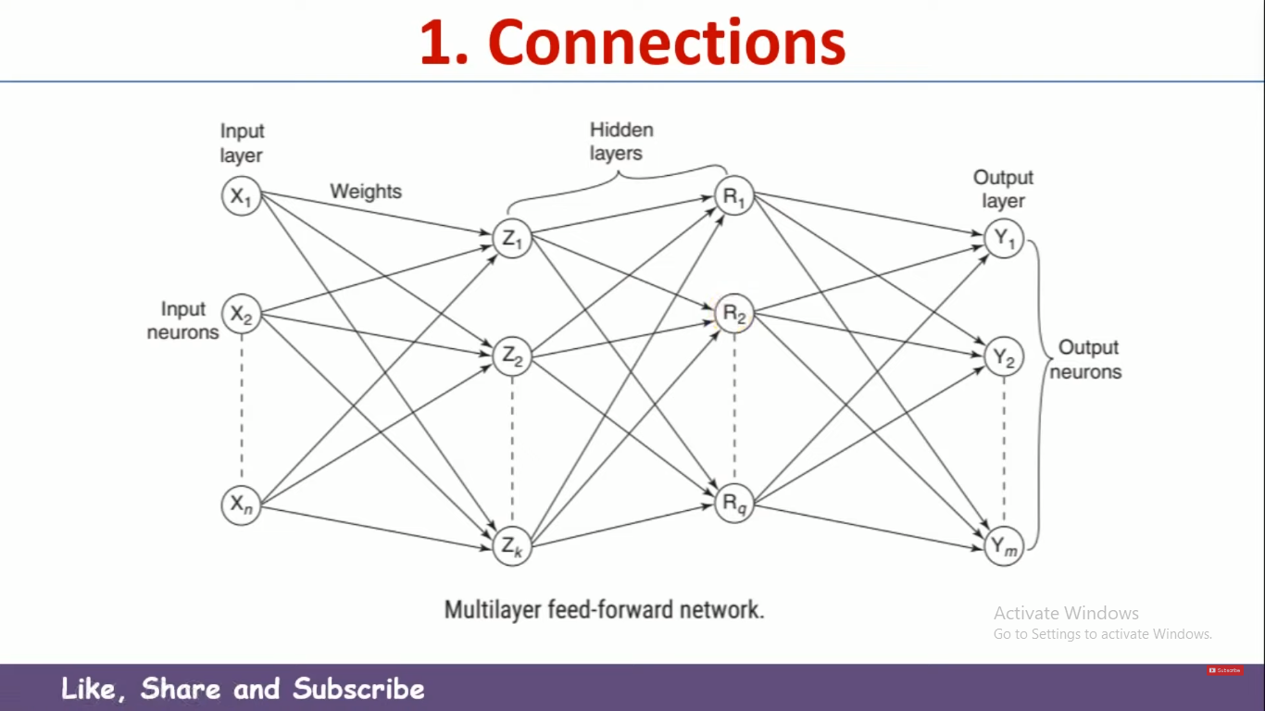
Notes:
INPUT LAYRES CONNECTED WITH HIDDEN LAYRES AND HIDDEN LAYRES CONNECTED WITH OUTPUT LAYRE

Slide 16

Notes:
IF THE OUTPUT IS CORRECT THEN SATIESFIED OTHERWISE THEY SEND BACK FEEDBACK OF OUTPUT AND AFTER THEN WE WILLMODIFY THE COMPUTIONAL DATA AND SEND AGAIN.

Slide 17
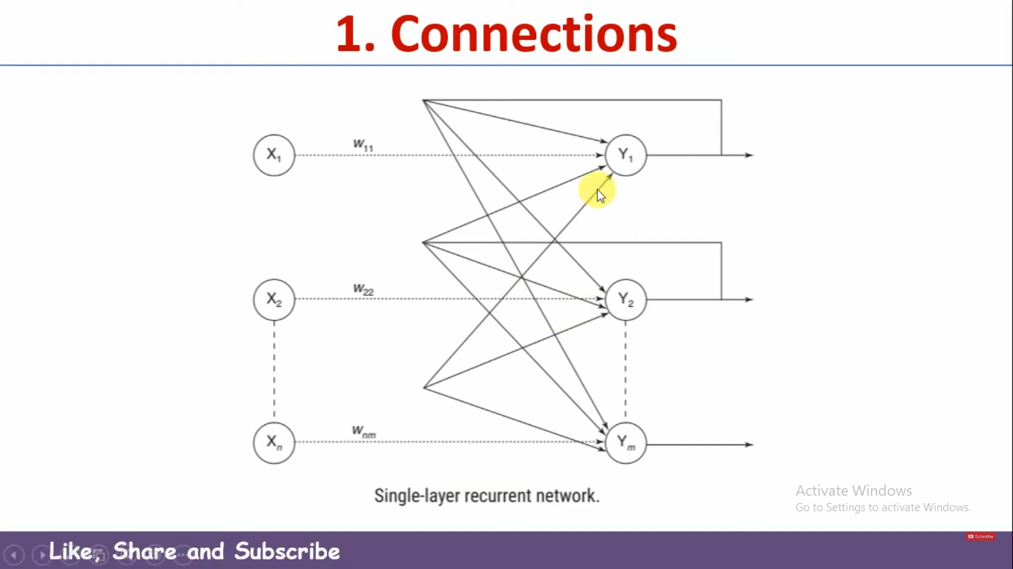
Notes:
WHILE MODIFYING OR UPDATING THIS PARTICULAR WEIGHTS RATHER THAN JUST CONSIDERING THE INPUT AS WELL AS PREVIOUS WEIGHT WE CONSIDER THE OUTPUT AS WELL IN THIS CASE.
THE OUTPUT OF THE PREVIOUS ULTRATION, THE INPUT WILL BE CONSIDER TO UPDATE THIS PARTICULAR WEIGHT OVER HERE

Slide 18
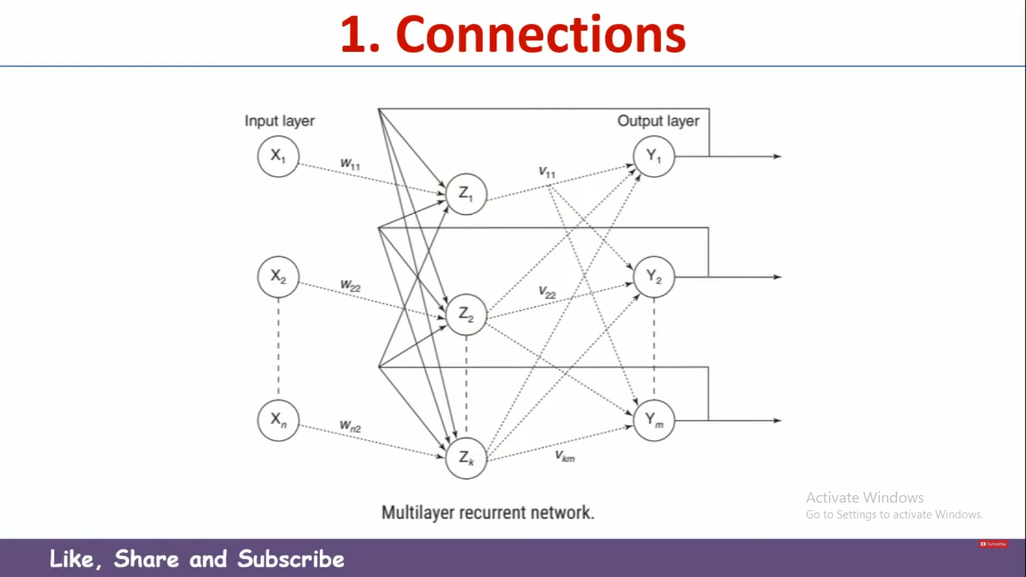

Slide 19
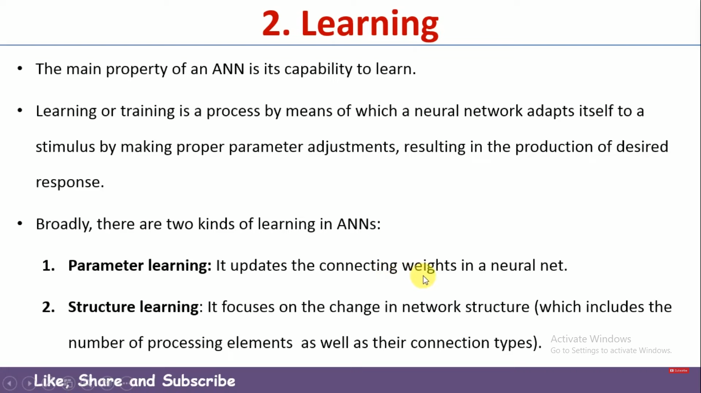

Slide 20


Slide 21


Slide 22


Slide 23


Slide 24


Slide 25


Slide 26


Slide 27
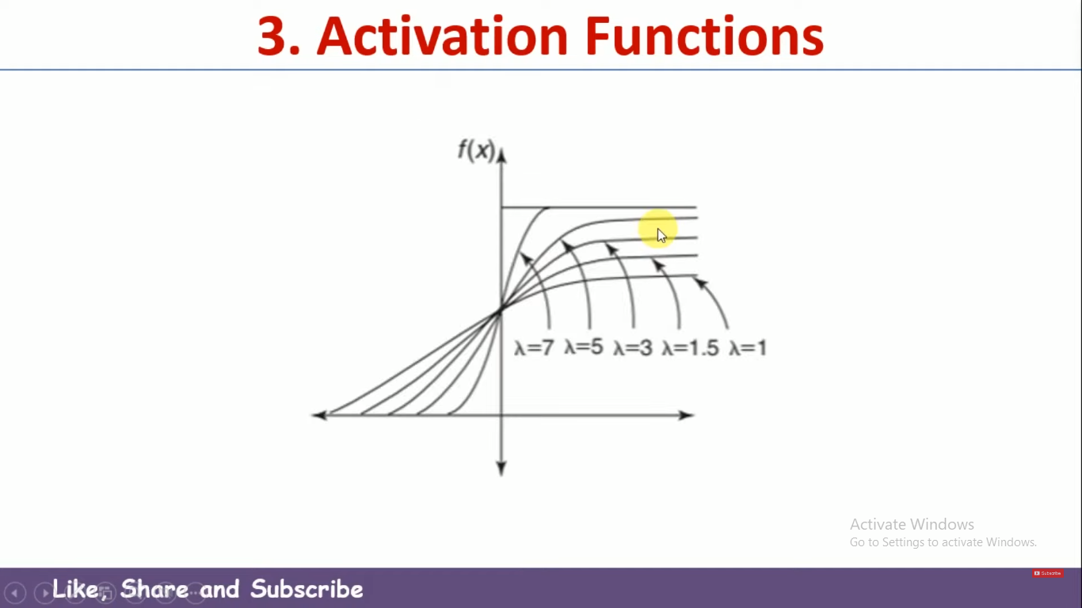

Slide 28


Slide 29
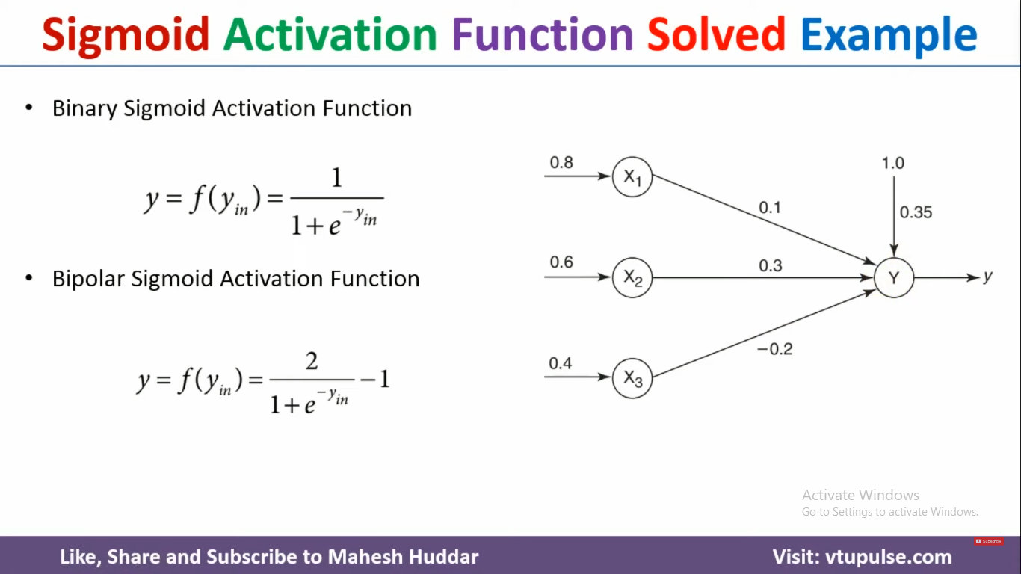

Slide 30
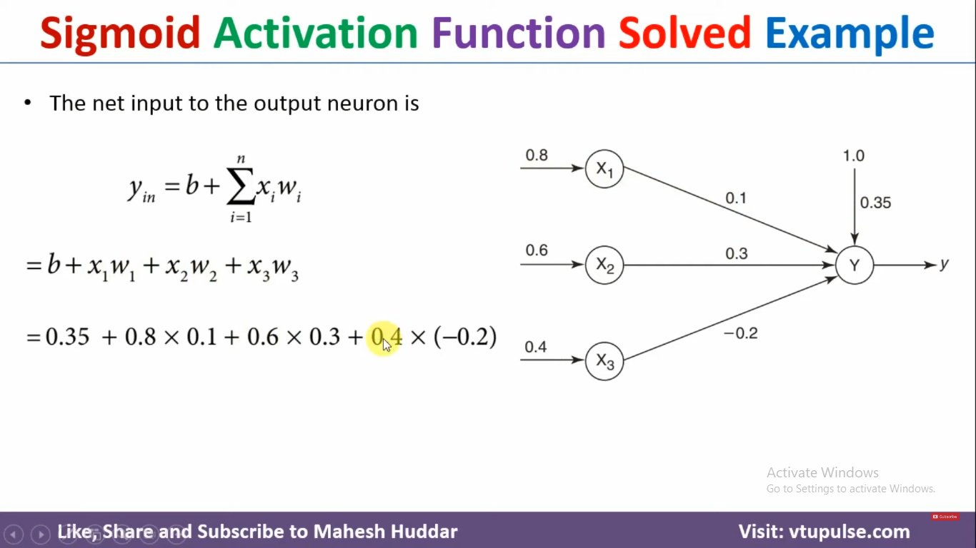

Slide 31
